Slide 1
Charmless B to VT decays in PQCD
Run-Hui Li
Yonsei Univ.
Collaborate with C.S. Kim, F. Simanjuntak, Z.T. Zou. Based on PRD 88,014031.

Slide 2
Content
Introduction ( see Prof. Lu’s report )
Disscusions & results
Summary

Slide 3
Introduction
Flavor physics has been thoroughly studied in several decades. Many topics are intensively studied. While for $B→VT$ decays:
Theoretical studies:
Experimental observations.
Quark model
Generalized factorization
ISGW
LF approach

Slide 4
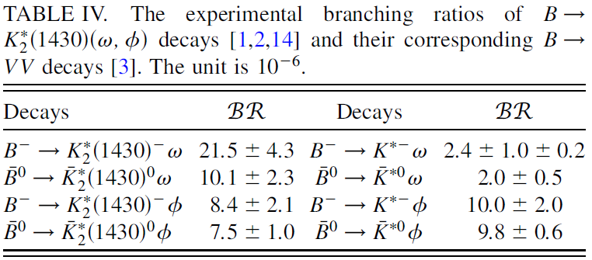
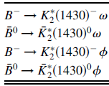
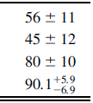
>
X 5
Polarization fractions, in unit of %.
In QCDF.
Charmed $B→VT$ decays in PQCD by Prof. C.D. Lu & students

Slide 5
Calculation of B meson two body non-leptonic decays

Slide 6
Charged Current
Tree operators
Flavor Changed Neutral Current

Slide 7
Deal with
Factorization
Else
LQCD
QCDF
SCET
PQCD
LFQM
LCSR
Collinear
Factorization
k_{T}
Factorization
●●● ●●●

Slide 8
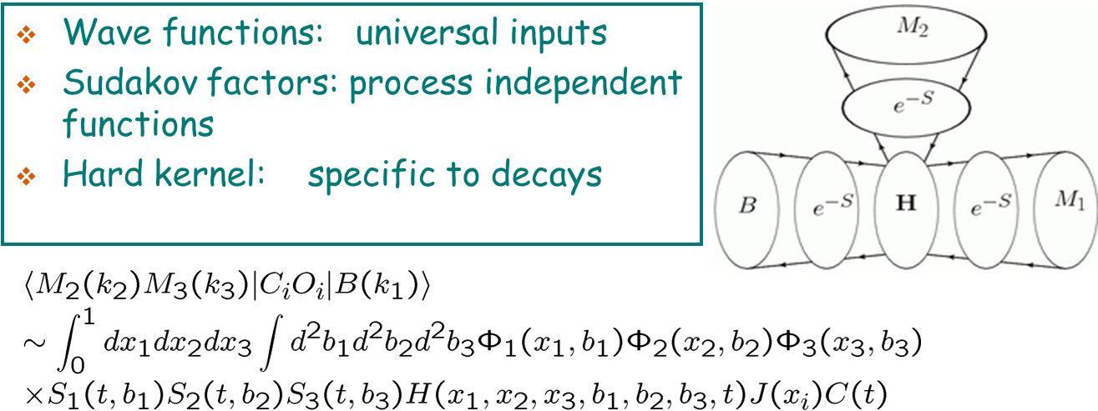
Calculation in PQCD

Slide 9
About tensor
$J^{P}=2^{+}$
Nonet: $a_{2}\left(1320\right), {K_{2}}^{∗}\left(1430\right), f_{2}\left(1270\right), {f_{2}}^{′}(1525)$
The spin-2 polarization tensor can be constructed by the spin-1 polarization vector:

Slide 10
Similarities with Vector mesons
By defining a new polarization vector
the tensor wave function can be expressed as
The wave function of the vector meson is
v is the light cone direction opposite to the one along which the tensor meson moves.

Slide 11
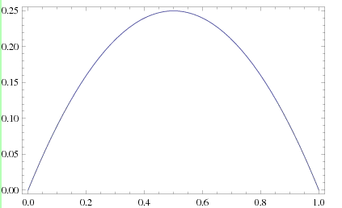
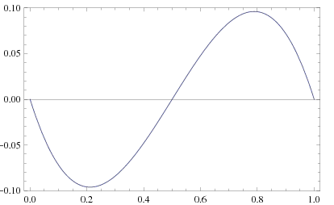
Difference of wave function behavior
Vector meson
Tensor meson
Asymptotic Form

Slide 12
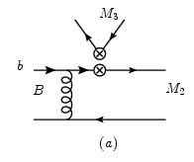
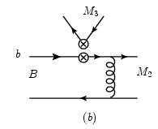
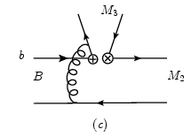
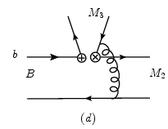
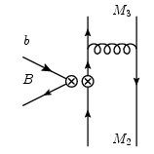
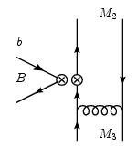
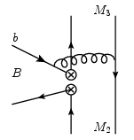
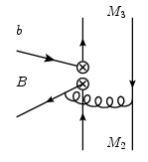
Topological Tree Diagrams in PQCD
Emission diagrams
Annihilation diagrams

Slide 13
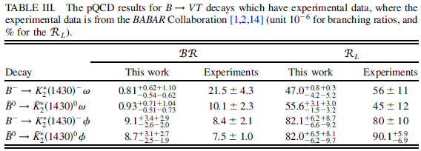
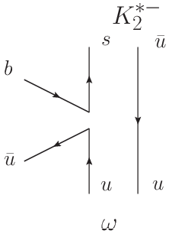
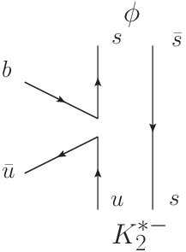
Results
PQCD can not explain all the BRs. QCDF can accommodate the data by fitting. However, hard to understand dynamically.
$${ρ_{A}}^{VT}≫{ρ_{A}}^{TV}$$
$$≫$$
PRD83,034001

Slide 14
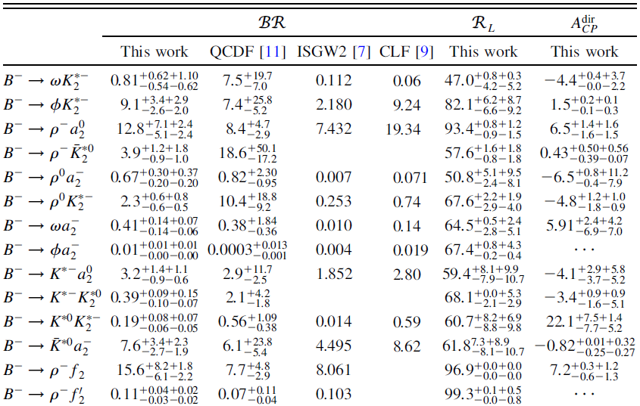
$$Some B^{−}→VT decays. Unit:BR \left({10}^{−6}\right), R_{L} \left(\%\right), A_{}^{\begin{aligned}dir \\ CP\end{aligned}}(\%)$$

Slide 15
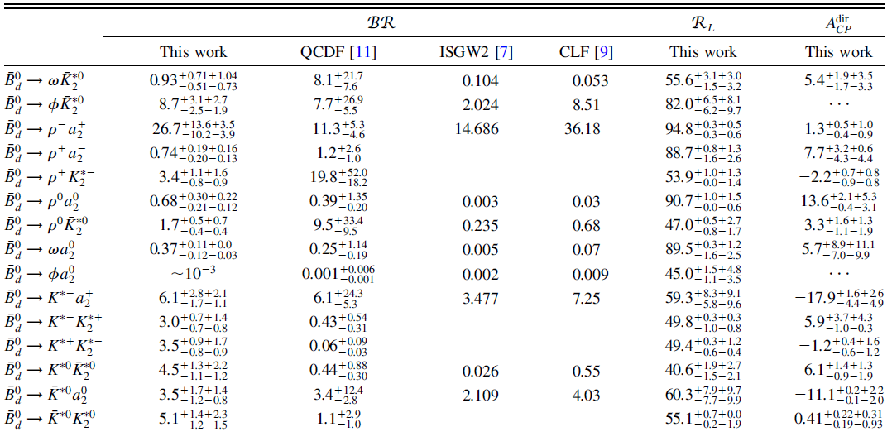
$$Some \overline{{B_{d}}^{0}}→VT decays. Unit:BR \left({10}^{−6}\right), R_{L} \left(\%\right), A_{}^{\begin{aligned}dir \\ CP\end{aligned}}(\%)$$

Slide 16
in
: weak phases from CKM matrix
: strong phases from hadronic matrix elements
: Tree magnitude
: Penguin magnitude
CP violation needs the interference of at least two weak amplitudes.

Slide 17
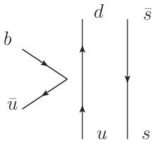
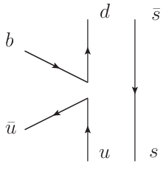
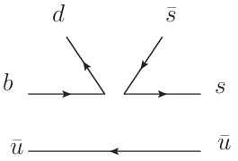
in
$$×2.5$$

Slide 18
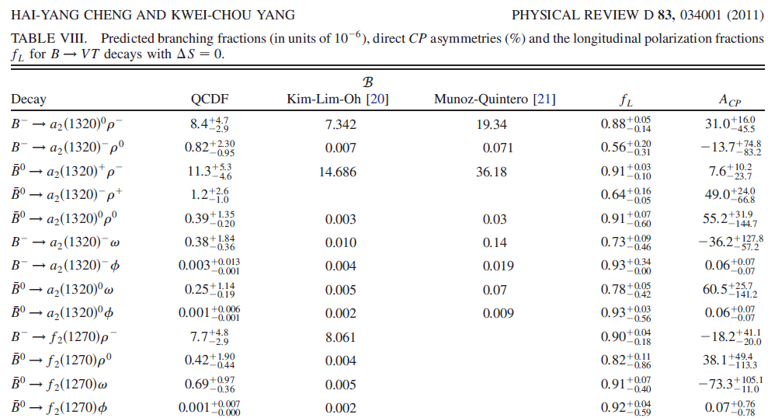
In QCDF

Slide 19
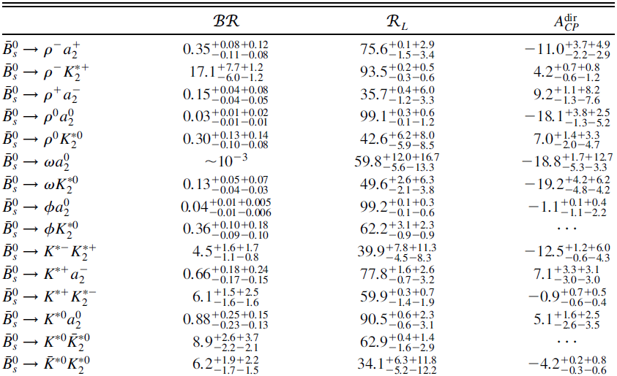
$$Some \overline{{B_{s}}^{0}}→VT decays. Unit:BR \left({10}^{−6}\right), R_{L} \left(\%\right), A_{}^{\begin{aligned}dir \\ CP\end{aligned}}(\%)$$

Slide 20
Summary
Charmless $B_{u,d,s}→VT$ decays are investigated in the PQCD approach.
The $BR$s of most $B_{u,d}$ decays are at the order of ${10}^{−6}$, some are ${10}^{−5}$. $BR$s of $B_{s}$ decays are mainly at ${10}^{−7}$.
In some decay channels, whose only tree operator contributions are suppressed by the annihilation diagrams, there might be a relatively large direct CP violation.
The current experimental data indicates a profound picture for $B→VT$ decays. More data is needed to understand the kinematics totally.
Thank you very much for your attention.

